Slide 1

Power BI Dashboard Summary
Internship project presentation by Joti Kumari Poddar.
Exploring impactful visual data storytelling.

Slide 2

Project Objective
Deliver actionable insights
Using dynamic Power BI dashboards.
Analyze business performance
Identify key trends and growth areas.

Slide 3
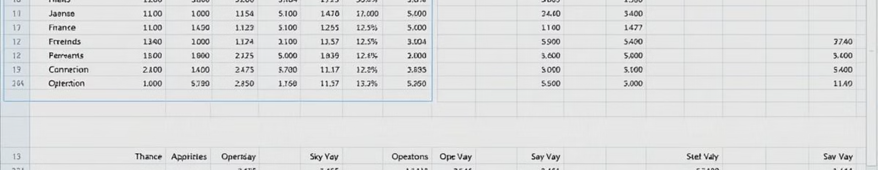
Data Sources
Organizational Data
Power BI Processing
Performance Metrics
Sales, finance, and operations records integrated.
Transforming raw data into interactive visual reports.
Sales quantity and category-based analysis included.

Slide 4
Key Metrics Monitored
Total sales
City-wise sales breakdown
Monthly sales growth
Customer rating status
Product category performance

Slide 5
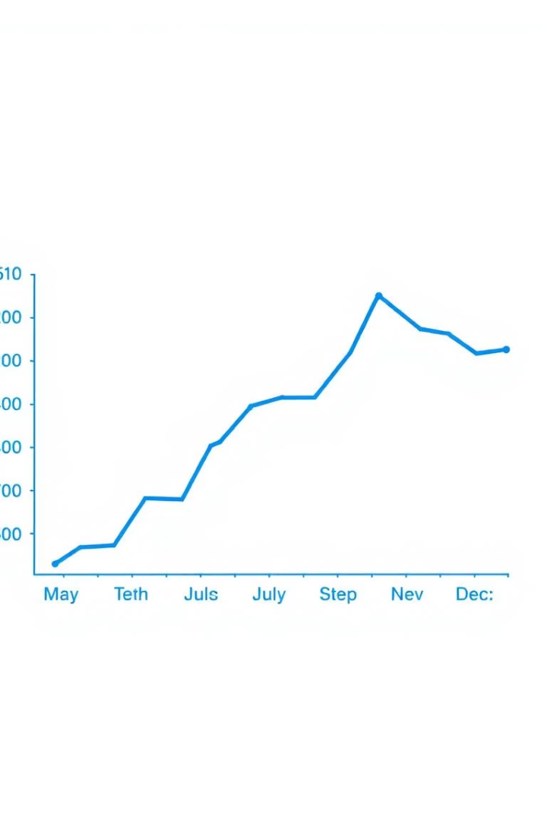



Visual Highlights: Monthly Sales Trend
Monthly Sales Growth
Tracking progress month-over-month.
Q3 Peak
Highest sales observed in third quarter.
Q1 Dip
Slight drop in early year sales.

Slide 6

Insights & Business Opportunities
1
Sales Growth
Improved over last two quarters.
2
Underperforming City
Opportunity for targeted marketing campaigns.
3
Top Products
Three products drive 60% of revenue.

Slide 7

Thank You
Open for questions and discussion.

